Slide 1

Processes, Threads, Concurrency, and Synchronization
Carlos Alberto Rincón Castro | carincon@uh.edu

Slide 2
Lecture Overview
Introduction: Processes vs. Threads
  Design Aspects
  Concurrency
Threads: Implementation Aspects
  User-level vs. Kernel-level
  Multithreading patterns
Synchronization
  Mutual Exclusion
  Hardware-based solutions
  Software-based solutions
Threads in the real world
  Synchronization and the OS
  Software solutions based on Threads

Slide 3
Processes vs. Threads
Process: is an instance of a program running on a computing system.
Process = Code + Data + Memory + Process Control Block
Instructions (code)
Data
Identifier
State
Priority
Program counter
I/O status information
Accounting information
Memory
Process Control Block
Fig 1. Simplified Process Image

Slide 4
Processes vs. Threads
Fork(): creating a process dynamically.
int main ()
{
pid_t pid;
pid = fork();
if (pid == 0) // Child Process Code
printf(”Child process\n”);
else
printf(”Parent process\n”);
return (0);
}
Instructions (code)
Data
Memory
Process Control Block
Parent Process
Instructions (code)
Data
Processes do not share their memory address space, but they share the opened files.
Memory
Process Control Block
Child Process

Slide 5
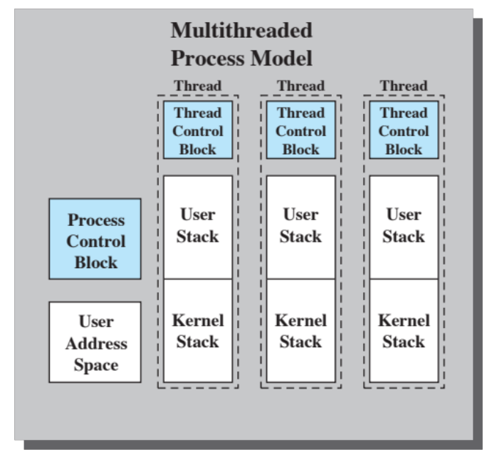
Processes vs. Threads
Threads:
  The unit of dispatching is referred to as a thread or lightweight process.
  The unit of resource ownership is referred to as a process or task.
Fig 2. Simplified Thread Image (Stallings, OS8e)

Slide 6
Processes vs. Threads
Threads Challenges:
  No memory protection inside an address space.
  Lightweight processes can now interfere with each other.
void * child ()
{
printf(”Child process\n”);
}
int main ()
{
thread_t tid;
pthread_create(&tid, NULL, child, NULL);
printf(”Parent process\n”);
return (0);
}
Stack Address (NULL = anywhere)
Parameters (void pointer)
POSIX Thread Example

Slide 7
Processes vs. Threads
Threads Example:
#define COUNT 5
void *inc_x(void *x_void_ptr)
{
int *x_ptr = (int *)x_void_ptr;
for (int i=0; i< COUNT; i++)
(*x_ptr)++;
return NULL;
}
load reg, M
inc reg
store reg, M
(*x_ptr)++
Thread 1 loads 0
Threads 3, 4, 5 run to completion
Thread 2 runs through 4 of its 5 iterations.
Thread 1 increments 0 to 1 and stores the result (1).
Thread 2 loads 1
Thread 1 runs to completion
Thread 2 increments 1 to 2 and stores 2
POSIX Thread Example

Slide 8
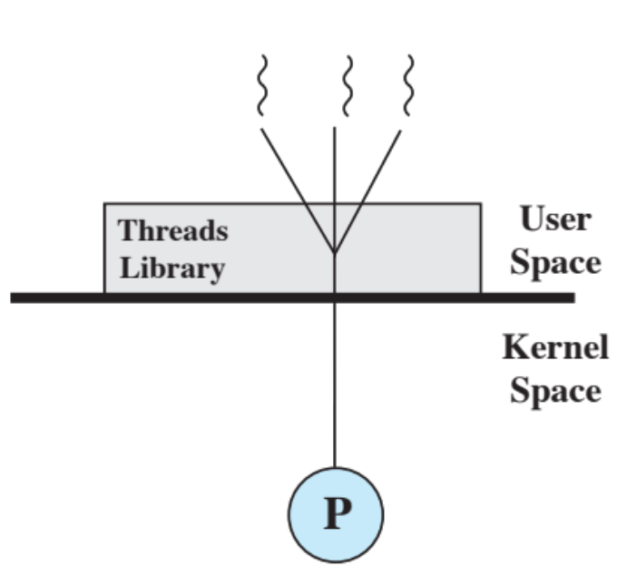
Threads: Implementation
User-Level Threads (ULTs):
  User-level threads are managed by procedures within the task address space by the thread library.
  The kernel is not aware of the existence of threads.
  Example: POSIX Threads (POSIX = Portable OS interface)
Fig 3. User-level Threads (Stalling OS8e)

Slide 9
Threads: Implementation
User-Level Threads (ULTs):
  Advantages:
    Thread switching does not require kernel mode privileges (no performance penalty).
    Scheduling can be application specific.
    Can be implemented on any OS.
  Disadvantages:
    A blocking call from one thread will block all the threads from the same process.
    Solution: Using non-blocking calls (not easy).
    Multithreaded programs cannot take advantage of multiprocessing

Slide 10
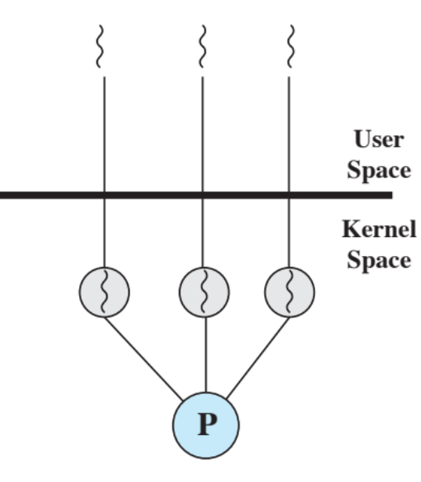
Threads: Implementation
Kernel-Level Threads (KLTs):
  Thread management is done by the kernel (one process table entry per thread).
  Best solution for multiprocessor architectures (kernel can allocate several processors to a single multithreaded task).
Fig 4. Kernel-level Threads (Stalling OS8e)

Slide 11
Threads: Implementation
Kernel-Level Threads (KLTs):
  Advantages:
    The kernel can simultaneously schedule multiple threads from the same process on multiple processors.
    If one thread in a process is blocked, the kernel can schedule another thread of the same process.
  Disadvantages:
    Switching from one thread to another within the same process requires two context switches (overhead).

Slide 12
Threads: Implementation
Multithreading patterns:
  Dispatcher-Worker pattern:
    Dispatcher Thread: reads the requests from the mailbox.
    Worker Thread: performs the task.
    Challenges:
      Dispatcher can be a bottleneck.
      Static / Dynamic Worker generation.
User Space
Requests
Mailbox
Kernel Space
Dispatcher Thread
Worker Thread

Slide 13
Threads: Implementation
Multithreading patterns:
  Pipeline pattern:
    Threads assigned one subtask in the system.
    Entire task = Pipeline of threads.
    Multiple tasks concurrently run in the system, in different pipeline stages
    Shared buffer based communication between stages.
    Challenges:
      Performance depends on weakest link.
      Dividing requests in subtasks.
User Space
Requests
Mailbox
Kernel Space
Thread for subtask

Slide 14
Threads: Implementation
Multithreading patterns:
  Example:
  For 5-step toy order application, we have the solutions using:
    Dispatcher-Worker pattern.
    Pipeline pattern.
  Constraints:
    For both patterns, we have 5 threads.
    For the dispatcher-workers solution, a worker produces a toy order in 100 ms.
    For the pipeline solution, each one of the five stages takes 20 ms.
    Time to read and process the request is negligible.
    How long will it take for these solutions to complete an 8-toy order and a 9-toy order?

Slide 15
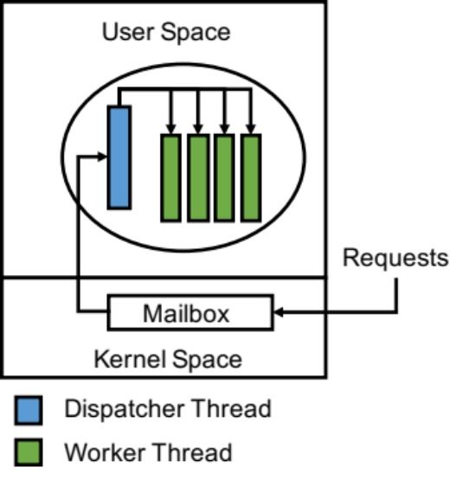
Threads: Implementation
Multithreading patterns:
Dispatcher-Worker pattern
  8-toy order:
  0 ms (reading + processing) +
  100 ms (processing 4 toy orders concurrently) +
  100 ms (processing 4 toy orders concurrently) =
  Total time = 200 ms.
  9-toy order:
  0 ms (reading + processing) +
  100 ms (processing 4 toy orders concurrently) +
  100 ms (processing 4 toy orders concurrently) +
  100 ms (processing 1 toy order)
  Total time = 300 ms.

Slide 16
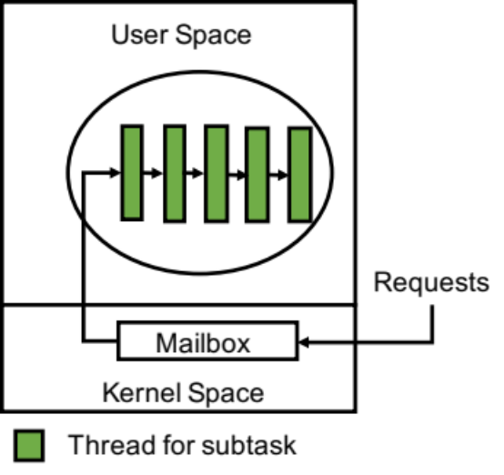
Threads: Implementation
Multithreading patterns:
Pipeline pattern
  8-toy orders:
  0 ms (reading + processing) +
  100 ms (time to finish first toy order) +
  20 ms * 7 (processing 7 toy orders) =
  Total time = 240 ms.
  9-toy orders:
  0 ms (reading + processing) +
  100 ms (time to finish first toy order) +
  20 ms * 8 (processing 8 toy orders) =
  Total time = 260 ms.

Slide 17
Threads: Synchronization
Mutual Exclusion:
Key Terms:
  Atomic operation: a function or action implemented as a sequence of one or more instructions that cannot be interrupted (indivisible).
  Critical Section: section of code within a process that requires access to shared resources that has to be executed as an atomic operation.
  Mutual Exclusion: property that guarantees that only one thread of execution will have access to a critical section for a particular shared resource at a particular time.
  Racing Condition: a situation when multiple threads or processes try to gain access to a particular shared resource at the same time.

Slide 18
Threads: Synchronization
Mutual Exclusion:
Challenges:
  Concurrency
    Detecting programming errors.
    Difficult for the OS to manage the allocation of resources optimally.
  Busy waits
    Example: while(TRUE); Wasting CPU cycles.
  Deadlocks
    Permanent blocking of a set of processes that compete for the same shared resource.
  Starvation
Postponing indefinitely the execution of a process based on a condition.

Slide 19
Threads: Synchronization
Mutual Exclusion:
Requirements:
  A process that halts must do so without interfering with other processes.
  No deadlock or starvation.
  A process must not be denied access to a critical section when there is no other process using it.
  No assumptions are made about relative process speeds or number of processes.
  A process remains inside its critical section for a finite period of time.

Slide 20
Threads: Synchronization
Mutual Exclusion: Hardware Solutions
Interrupt Disabling
Disabling interrupts guarantees mutual exclusion
  int main()
  {
  disableInterrupt();
  // Critical section goes here
  enableInterrupt();
  }
Disadvantages:
  The performance of the system could be noticeably degraded.
  Not suitable for Multiprocessor platforms.

Slide 21
Threads: Synchronization
Mutual Exclusion: Hardware Solutions
Special Machine Instructions
  Test and Set
  Exchange
  Carried out atomically.
  /* program mutualexclusion */
  const int n = /* number of processes */;
  int bolt;
  void main()
  {
  bolt = 0;
  parbegin (P(1), P(2), . . . ,P(n));
  }
  void P(int i)
  {
  while (true)
  {
  while (!test_and_set(&bolt))
  /* do nothing */;
  /* critical section */;
  bolt = 0;
  /* non-critical section */;
  }
  }

Slide 22
Threads: Synchronization
Mutual Exclusion: Hardware Solutions
Special Machine Instructions
  Advantages:
    Applicable to uniprocessors and multiprocessors.
    Simple and easy to verify.
    Supports multiple critical sections.
  Disadvantages:
    Busy-wait is employed.
      We have to avoid busy waits on single-core architectures.
      We can use them only for short waits on multicore architectures.
    Starvation is possible.

Slide 23
Threads: Synchronization
X
Mutual Exclusion: Software Solutions
Peterson’s Algorithm
#define LOCKED 1
#define UNLOCKED 0
int lock = UNLOCKED; // shared
int main()
{
while (lock == LOCKED); // busy wait
lock = LOCKED;
Critical_Section();
lock = UNLOCKED;
return(0);
}
Solution:
Move Lock=LOCKED before
while (lock == LOCKED); // busy wait
Result:
Deadlock

Slide 24
Threads: Synchronization
Mutual Exclusion: Software Solutions
Peterson’s Algorithm
// shared variables
int reserved[2] = {FALSE, FALSE};
int mustwait; // tiebreaker
int main()
{
int other= 1 ‐ pid; //other process
reserved[pid] = TRUE;
must_wait = pid; // set tiebraker
while (reserved[other] && must_wait==pid);
// Critical Section
reserved[pid] = FALSE;
return(0);
}
Solution:
When two processes arrive in lockstep, last one must wait.
Result:
Mutual Exclusion

Slide 25
Threads: Synchronization
Mutual Exclusion: Software Solutions
Semaphores
Special integer variables.
May be initialized to a nonnegative integer value.
Two atomic primitives
  SemWait operation decrements the value (P() or Down)
  The semSignal operation increments the value (V() or Up).

Slide 26
Threads: Synchronization
Mutual Exclusion: Software Solutions
Semaphores
Normal implementation:
  Processes waiting for a semaphore whose value is zero are put in the blocked state.
  Busy waits are eliminated.
Strong Semaphores: FIFO order
Weak Semaphores: No specific order.

Slide 27
Threads: Synchronization
Mutual Exclusion: Software Solutions
Semaphores
Producer – Consumer Problem: only one producer or consumer may access the buffer at any one time.
void producer()
{
while (true)
{ produce();
semWaitB(s);
append();
n++;
if (n==1)
semSignalB(delay);
semSignalB(s);
}
}
void consumer()
{
semWaitB(delay);
while (true)
{
semWaitB(s);
take();
n--;
semSignalB(s);
consume();
if (n==0)
semWaitB(delay);
}
}
int n;
binary_semaphore s = 1;
binary_semaphore delay = 0;

Slide 28
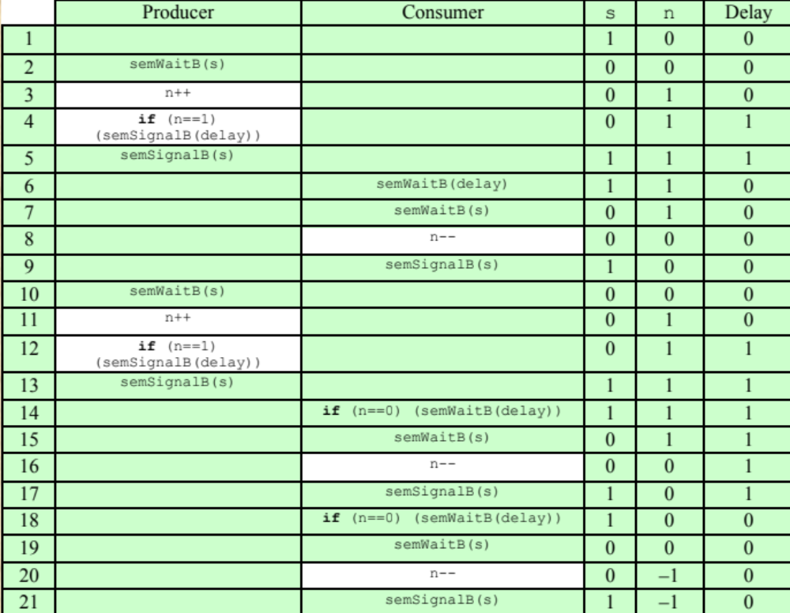
Threads: Synchronization
Semaphores: Producer - Consumer
Fig 5. Producer - Consumer (Stalling OS8e)

Slide 29
Threads: Synchronization
Semaphores: Producer - Consumer
Solution 2
Solution 1
semaphore n = 0;
semaphore s = 1;
void consumer()
{
semWaitB(delay);
while (true)
{
semWaitB(s);
take();
n--;
m=n;
semSignalB(s);
consume();
if (m==0)
semWaitB(delay);
}
}
void producer()
{
while (true)
{
produce();
semWait(s);
append();
semSignal(s);
semSignal(n);
}
}
void consumer()
{
while (true)
{
semWait(n);
semWait(s);
take();
semSignal(s);
consume();
}
}

Slide 30
Threads: Synchronization
Mutual Exclusion: Software Solutions
Monitors
Software module consisting of one or more procedures, an initialization sequence, and local data.
Local data variables are accessible only by the monitor’s procedures and not by any external procedure.
Process enters monitor by invoking one of its procedures.
Only one process may be executing in the monitor at a time.

Slide 31
Threads: Synchronization
Mutual Exclusion: Software Solutions
Monitors
Implemented in a number of programming languages including Concurrent Pascal, Pascal-Plus, Modula-2, Modula-3, and Java
Achieved by the use of condition variables using the primitives:
  cwait(c): suspend execution of the calling process on condition c.
  csignal(c): resume execution of some process blocked after a cwait(c). (Hoare semantics)
  cnotify(c): resume execution of all processes waiting for condition c. (Mesa semantics).

Slide 32
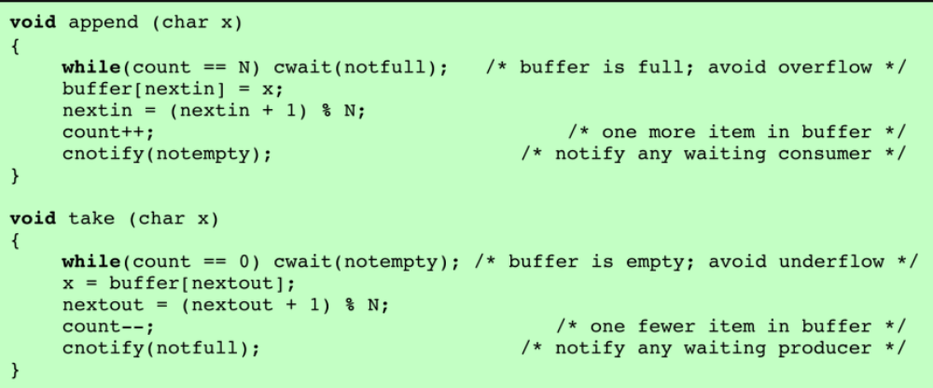
Threads: Synchronization
Mutual Exclusion: Software Solutions
Monitors
Producer – Consumer problem:
Fig 6. Producer – Consumer with Mesa semantics (Stalling OS8e)

Slide 33
Threads in the real world
Synchronization and the OS
Windows
  Uses interrupt masks to protect access to global resources on uniprocessor systems.
  Uses spinlocks on multiprocessor systems (Spinlocking-thread will never be preempted).
  Also provides dispatcher objects (user-space) which may act as mutexes, semaphores, events, and timers (an event acts much like a condition variable).

Slide 34
Threads in the real world
Synchronization and the OS
Linux:
  Prior to kernel Version 2.6, disables interrupts to implement short critical sections.
  Version 2.6 and later, fully preemptive
  Linux provides:
    Semaphores
    Spinlocks
    Reader-writer locks
  On single-cpu system, spinlocks replaced by enabling and disabling kernel preemption.

Slide 35
Threads in the real world
Synchronization and the OS
PThreads:
  Pthreads API is OS-independent
  It provides:
    Mutex locks
    Condition variables
  Non-portable extensions include:
    Read-write locks
    Spinlocks

Slide 36
Threads in the real world
Alternative Aproaches
Transactional Memory
A memory transaction is a sequence of read-write operations to memory that are performed atomically.
OpenMP
  API that support parallel programming.
  #pragma omp critical directive is treated as a critical section and performed atomically.
Functional Programming Languages
  Functional programming languages do not maintain state.
  Variables are treated as immutable and cannot change state once they have been assigned a value.
  Examples: Earlang and Scala

Slide 37
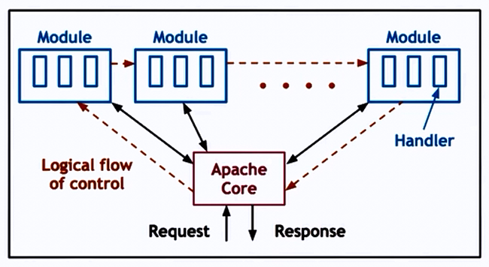
Threads in the real world
Applications
Core: basic server skeleton
Modules: per functionality
Flow of Control: Similar to Event Driven model
A combination of MP + MT Each process = dispatcher/worker with dynamic thread pool Number of processes can also be dynamically adjusted.
Fig 6. Producer – Apache Web Server (1)
1. https://applied-programming.github.io/Operating-Systems-Notes/3-Threads-and-Concurrency/#event-driven-model

Slide 38
Lecture Summary
Introduction: Processes vs. Threads
  Design Aspects
  Concurrency
Threads: Implementation Aspects
  User-level vs. Kernel-level
  Multithreading patterns
Synchronization
  Mutual Exclusion
  Hardware-based solutions
  Software-based solutions
Threads in the real world
  Synchronization and the OS
  Software solutions based on Threads

